Slide 1
BiODECON seminar & EXSY reading group
Elena casetta & Silvia di marco
“How HAS Biodiversity been Defined?”
Mare | fcul | july 6, 2016
DeLong, D.C.,1996, Defining biodiversity. Wildlife Soc Bull 24: 738–749
Sarkar, S., 2002, Defining “biodiversity”. Assessing biodiversity. The monist 85/1: 131-155

Slide 2
DeLong 1996
DeLong: A definition of biodiversity is needed that (1) has sound foundation in semantics and etymology, (2) is consistent with the meaning of other ecological terms, and (3) is not biased toward any particular discipline. (p. 738)
Sarkar: “Biodiversity” must be analyzed in the context of conservation biology and what it, as a goal-oriented enterprise that prescribes policies, must accomplish as it tries to conserve biodiversity. (p. 132)

Slide 3
DeLong 1996
Aim: To put forward a sound and objective definition of biodiversity
Method:
Literature review
Scope of ecological components and processes
Characterization of diversity (cf. table p. 739)
Logic and semantic analysis based on five approaches
Derivation (etymology)
Classification (genus-difference)
Listing characteristics, properties, qualities, and parts (by essential parts)
Comparison and contrast
Operation

Slide 4
Definition by derivation
Root: diversity
Bio = living organisms, assemblages of living organisms, and the activities and interactions of living organisms (740)
Rules out definition that include abiotic components (ecosystems)

Slide 5
Definition by classification
Class (genus): diversity
Differentia (species): bio
“Biodiversity is a type of diversity”
Which class for “diversity”?
State or attribute, condition, quality
Measure or index (of a state or attribute) => quantitative operational definition

Slide 6
Definition by characteristics, properties, …
Composition: identity and richness of the biotic component and relative amount
Structure: vertical and horizontal elements of a community or landscape, and the organization levels of plant and animal populations and assemblages. => link to concepts of habitat diversity and niche width
Function: Biotic processes (number, type, rate), such as herbivory, predation, parasitism, mortality, production, vegetative succession, biotic nutrient cycling and energy flow, colonization and extinction, genetic drift, mutation. => From organism level to biogeographical scale

Slide 7
Definition by comparison and contrast
Species richness and diversity < biodiversity
Ecological diversity (biotic and abiotic components) > biodiversity
Native biodiversity < biodiversity
Definitions and designators (terms selection for precise definition)
“The number and relive abundance of all of the species within a given area” (Art 1993) ≈ species diversity
“… includes the variety of living organisms, the genetic differences among them, the communities and ecosystems in which they occur, and the ecological and evolutionary processes that keep them functioning, yet ever changing and adapting.” (Noss & Cooperrider 1994) ≈ ecological diversity
Notes:
Ecological diversity is necessary for biodiversity conservation, but it’s not part of the definition of biodiversity. To equate/include ecological diversity in biodiversity is to confuse a definition with a functional relationship. Biodiversity is a component of ecological diversity. (p. 743)
Limiting the scope of biodiversity to native biodiversity would (1) introduce a value judgment, opening the way to all kind of value judgment, (2) hamper communication because different disciplines or groups define what is native in different ways.

Slide 8
Definition by operation
“Attempts to limit the fundamental meaning of biodiversity so that is is more practical to measure, and thus manage, contribute to this confusion [over how biodiversity concepts can be practically implemented].” (744) => if biodiversity is what we can measure, then it changes over time and according to available means
“A definition of biodiversity should portray the full scope of what the term means, not just what can be measured and managed. In contrast, monitoring or management objectives must be attainable to be effective” (755)
Definition ≠ measurement ≠ management

Slide 9
DeLong’s definition (1)
“Biodiversity is a state or attribute of a site or area and specifically refers to the variety within and among living organisms, assemblages of living organisms, biotic communities, and biotic processes, whether naturally occurring or modified by humans. Biodiversity can be measured in terms of genetic diversity and the identity and number of different types of species, assemblages of species, biotic communities, and biotic processes, and the amount (e.g. abundance, biomass, cover, rate) and structure of each. It can be observed and measured at any spatial scale ranging from microsites and habitat patches to the entire biosphere.” (745)

Slide 10
DeLong’s definition (2)
“Biodiversity is an attribute of a site or area that consists of the variety within and among biotic communities, whether influenced by humans or not, at any spatial scale from microsites and habitat patches to the entire biosphere.” (745)
“Biodiversity is the variety of life […]. In fact, variety-of-life can be viewed as a synonym of biological diversity.” (746)
Applying DeLong’s own criteria of semantic analysis, we should get rid of the term biodiversity (cf. definitions by comparison and contrast)

Slide 12
1. Difficulties in defining “biodiversity” and in measuring biodiversity
Neither definite definition of ‘biodiversity’, neither definite way of measuring general biodiversity.
Difficulty in defining stems from the fact that the biological realm is marked by variability at every level of complexity. Here we focus on entities (S. claims that the focus on processes leads to the conservation of integrity rather than diversity and is beyond the scope of the paper).

Slide 13
2. Two kinds of definition
Explicit definition. Sarkar: by necessary and sufficient conditions; cf. Macagno, genus-difference def. (Notice: Aristotelian definition is just one kind of explicit definition).

Slide 14
Best candidates
- (ED1): ‘biodiversity’ refers to spatial or taxonomic hierarchy. Cons: this amounts saying that ‘biodiversity’ refers to all biological entities. Conservation would be an impractical proposal.
- (ED2): ‘biodiversity’ refers to gene/species/ecosystems. Cons: it cannot account of those biological phenomena that do not depend on gene/species/ecosystem and that, still, are an important part of biodiversity (cf. in particular “endangered biological phenomena” such as Monarch butterfly migration; seasonal migrations of wildebeest in Africa; synchronous flowering of bamboo in India).

Slide 15
Implicit definition. Sarkar: by a set of axioms in which the concept occurs, e.g. “natural number” is implicitly defined by Peano’s axioms; “force” is implicitly defined by Newton’s axioms and his law of gravitation. E.g.
1. Zero is a number.
2. If a is a number, the successor of a is a number.
3. Zero is not the successor of a number.
4. Two numbers of which the successors are equal are themselves equal.
5. If a set S of numbers contains zero and also the successor of every number in S, then every number is in S.
(In the case of biodiversity it won’t be axioms but algorithms, i.e. procedures)

Slide 16
3. Defining & Assessing
3.1. “Biodiversity is what is being conserved by the practice of conservation biology”
Sociologically synergistic interaction between the use of ‘biodiversity’ and the growth of conservation biology è Biodiversity has to be implicitly defined as what is being conserved by the practice of conservation biology (cf. Kitcher 1984: “The most accurate definition of 'species' is the cynic's. Species are those groups of organisms which are recognized as species by competent taxonomists. Competent taxonomists, of course, are those who can recognize the true species.”)

Slide 17
Which conservation practices?
Conservation biology cf. Medicine. Ameliorative (species) vs. preventive (places). We should focus on the preventive part of conservation biology.
Unified framework for this task (“has emerged though … it has never been fully and explicitly presented”): “adaptive management of landscapes” (= mosaic of interacting ecosystems at any scale) which actually consists in prioritization of places for biodiversity value + procedures for the long-term survival of the biological units of interest (typically species).

Slide 18
A place is “a specific region on Earth’s surface filled with the particular results of its individual story”. This makes places different from ecosystems or habitats, “both of which are supposed to admit abstract characterization: the same habitat at different places may hold a different complement of genes, species, communities … ”
Is the choice for places well argued for?
(a) Is it true that preventive conservation biology focuses on places?
(b) Are places ≠ habitats & ecosystems because places are concrete particulars while habitats and ecosystems are not? Not sure. I can generalize and classify them, yet that particular ecosystem as well as that particular habitat is a unique entity, the result of its own story etc.

Slide 19
Circularity?
(p. 132) Purpose of the paper: to add enough precision to the concept of biodiversity (i.e. defining?) to make its ordinal, if not quantitative assessment plausible - - E.g. p’s biodiversity is n; p’s biodiversity is higher than q’s biodiversity and lower than z’s biodiversity. (Cf. clinical and medical psychology practices, Wilco et al.)
(p. 140) Method: If a definition of ‘biodiversity’ is to have any practical application, the problem of assessing biodiversity must be solved. Assessing problem is made of two problems: (1) Problem of quantification. What is to be measured? (2) Problem of assessing. Can we realistically obtain the data that we want?
Definition is needed to assess, but to define we need to solve the assessment problem.

Slide 20
The solution requires the choice of surrogates “that serve as indicators of general biodiversity ... Surrogacy is a relation (to stand for) between a surrogate or indicator variable and a target variable. (Not clear: which is the difference between surrogates and indicators? Why keep them distinct?)
A true surrogate stands for general biodiversity (target variable) ≠ An estimator surrogate, which stands for a true surrogate (target variable).
True surrogate è general biodiversity
Candidates: Character or trait diversity; Species diversity; Life-zone diversity; Environmental parameter diversity.
Trouble: The relation cannot be tested.

Slide 21
Estimator surrogate è True surrogate
Estimator surrogates’ candidates: Species richness; environmental parameter composition; soil-type composition; dominant-vegetation composition; species composition; life-zone composition; genus or other higher-taxon composition; subset of species composition.
The relation is an empirical one, to be investigated through field work.

Slide 22
3.3. How it works
What we have in hand is a set of places and a list of estimator surrogates, and we have to prioritize places. “The prioritization procedure will implicitly define what ‘biodiversity’ is taken to be” (p. 146). Notice: to prioritize, no absolute measure of biodiversity is needed; we merely need to be able to decide whether a place A has greater biodiversity than B.
On this basis, an operationally precise definition of biodiversity as a relative concept (i.e. allowing an ordinal assessment and only against a background set of places Π) can be given.

Slide 23
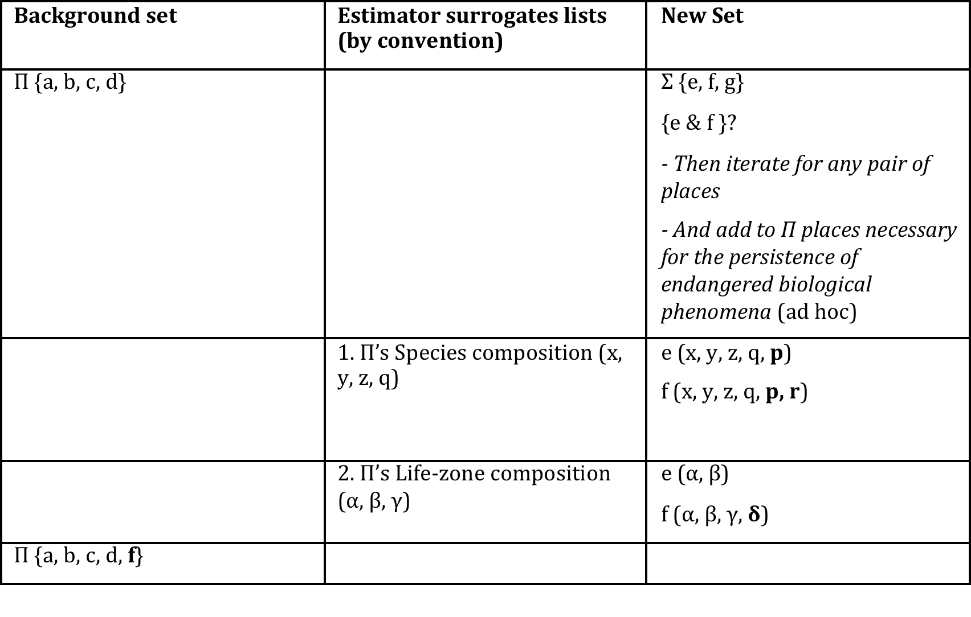

Slide 24
Complementary rule for prioritization.
Tie scenario: different ways to break ties (random; rarity (higher priority to the place which has more rare surrogates); adjacency; area; cost…) generates slightly different algorithms. Each algorithm defines a different concept of biodiversity (hence we end up with a family of definitions).
Problem of how Π is construed from the null set. In practice this is rarely a problem (we start with an already established network of protected areas). In principle: rarity (we chose the places that have the rarest surrogates).

Slide 25
4. Conclusions
“Biodiversity is the relation used to prioritize places.” (p. 148)
The crucial rule is complementarity (which captures our intuition that biodiversity has to do with novelty). The other fundamental rule is rarity (which captures our intuition that biodiversity has to do with the risk of extinction).
The main problem with Sarkar’s definition is that it leaves out of the game the plurality of actors involved in conserving biodiversity (non-expert society, stakeholders, decision makers…) Question is: can this implicit definition be translated in an explicit one?

